Slide 1


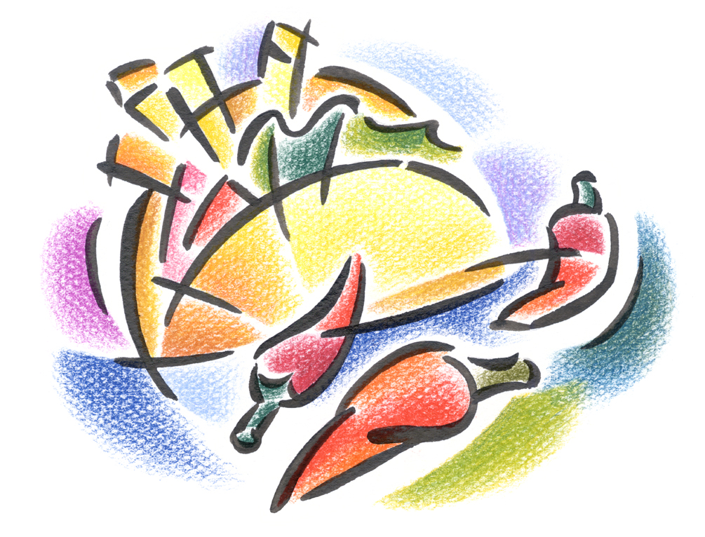
Dinner at Casa de Jane
You are cordially invited to a nice, relaxing, romantic Mexican dinner at a date of your choosing. Enjoy a great meal, some engaging conversation followed by a cozy movie. Dessert is also included.
Date: TBD
Time: 5 pm until ?
Place: removed xx

